Slide 1
Introduction To AGILE

Slide 2
Agenda
History
What is Agile
How does it work?
Why we use Agile Methods Agile Manifesto
Agile Methodologies Scrum
●
●
●
●
●
●
●

Slide 3
History
●
In 2001, this new management paradigm began to pick up momentum, agile was formalized when 17 pioneers of the agile methodology met at the Snowbird Ski Resort in Utah and issued the Agile Manifesto.
1.Kent Beck 2.Mike Beedle 3. Arie van Bennekum
4. Alistair Cockburn 5.Ward Cunningham 6.Martin Fowler 7.James Grenning 8.Jim Highsmith 9.Andrew Hunt
10.Ron Jeffries 11.Jon Kern 12.Brian Marick 13.Robert C. Martin 14.Steve Mellor 15.Ken Schwaber 16.Jeff Sutherland 17.Dave Thomas

Slide 4
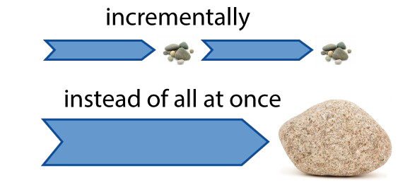
What is Agile?
●
Agile is a time boxed, iterative approach to software delivery that builds software incrementally from the start of the project, instead of trying to deliver it all at once near the end.
It works by breaking projects down into little bits of user functionality called user stories, prioritizing them, and then continuously delivering them in short two week cycles called iterations.
●

Slide 5
How does it work?
You make a list:
Sitting down with your customer you make a list of features they would like to see in their software. We call these things user stories and they become the To Do list for your project.
You size things up:
You size(estimate) your stories relatively to each other, coming up with a guess as to how long you think each user story will take.
You set some priorities:
Like most lists, there always seems to be more to do than time allows. So you ask your customer to prioritize their list so you get the most important stuff done first, and save the least important for last.
●
●
●

Slide 6
Cont...
You start executing:
●
Then you start delivering some value. You start at the top. Work your way to the bottom. Building, iterating, and getting feedback from your customer as you go.
You update the plan as you go :
Then as you and your customer starting delivering one of two things is going to happen. You'll discover:
You're going fast enough. All is good. Or,
You have too much to do and not enough time.
At this point you have two choices. You can either a) do less and cut scope (recommended). Or you can b) push out the date and ask for more money.
●
●

Slide 7
Why Use Agile Methods
Improve Customer Involvement Increase Quality
Simplify Releases Drive Down Risk
●
●
●
●

Slide 8
Advantages of Agile Model:
Customer satisfaction by rapid, continuous delivery of useful software.
People and interactions are emphasized rather than process and tools. Customers, developers and testers constantly interact with each other.
Working software is delivered frequently (weeks rather than months). Face-to-face conversation is the best form of communication.
Close, daily cooperation between business people and developers. Continuous attention to technical excellence and good design.
Regular adaptation to changing circumstances.
Even late changes in requirements are welcomed
●
●
●
●
●
●
●
●

Slide 9
Disadvantages of Agile model:
●
In case of some software deliverables, especially the large ones, it is difficult to assess the effort required at the beginning of the software development life cycle.
●
The project can easily get taken off track if the customer representative is not clear what final outcome that they want.
●
Only senior programmers are capable of taking the kind of decisions required during the development process. Hence it has no place for newbie programmers, unless combined with experienced resources.

Slide 10
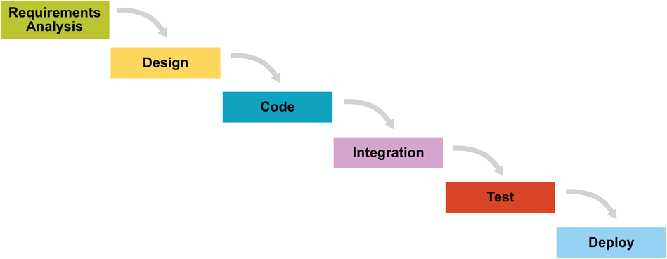
WATERFALL vs AGILE

Slide 11
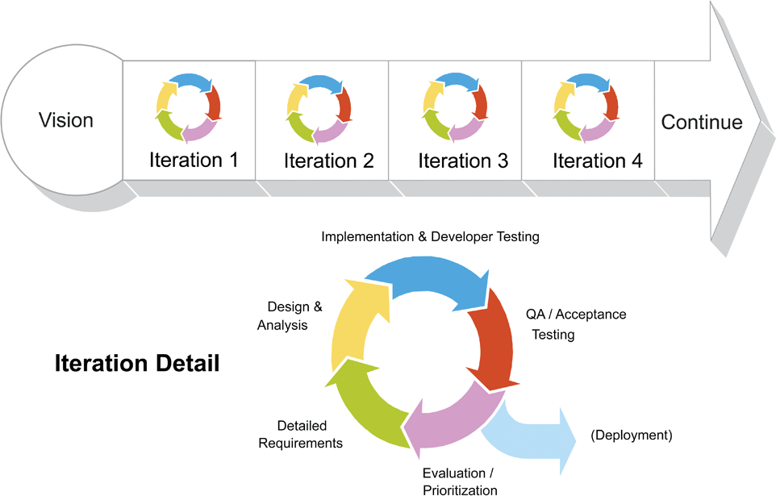
WATERFALL vs AGILE

Slide 12
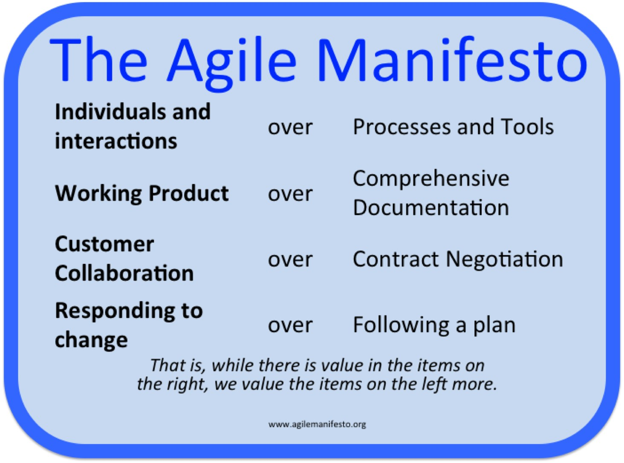
AGILE MANIFESTO

Slide 13
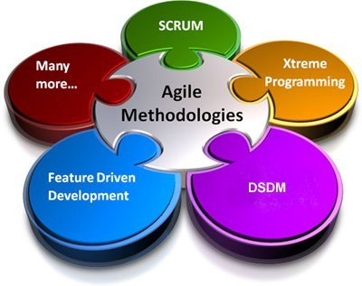
Agile Methodologies
Scrum
Extreme Programming (XP)
Dynamic Systems Development Method (DSDM)
Feature-Driven Development (FDD)
Lean and Kanban Software Development
Crystal
●
●
●
●
●
●

Slide 14
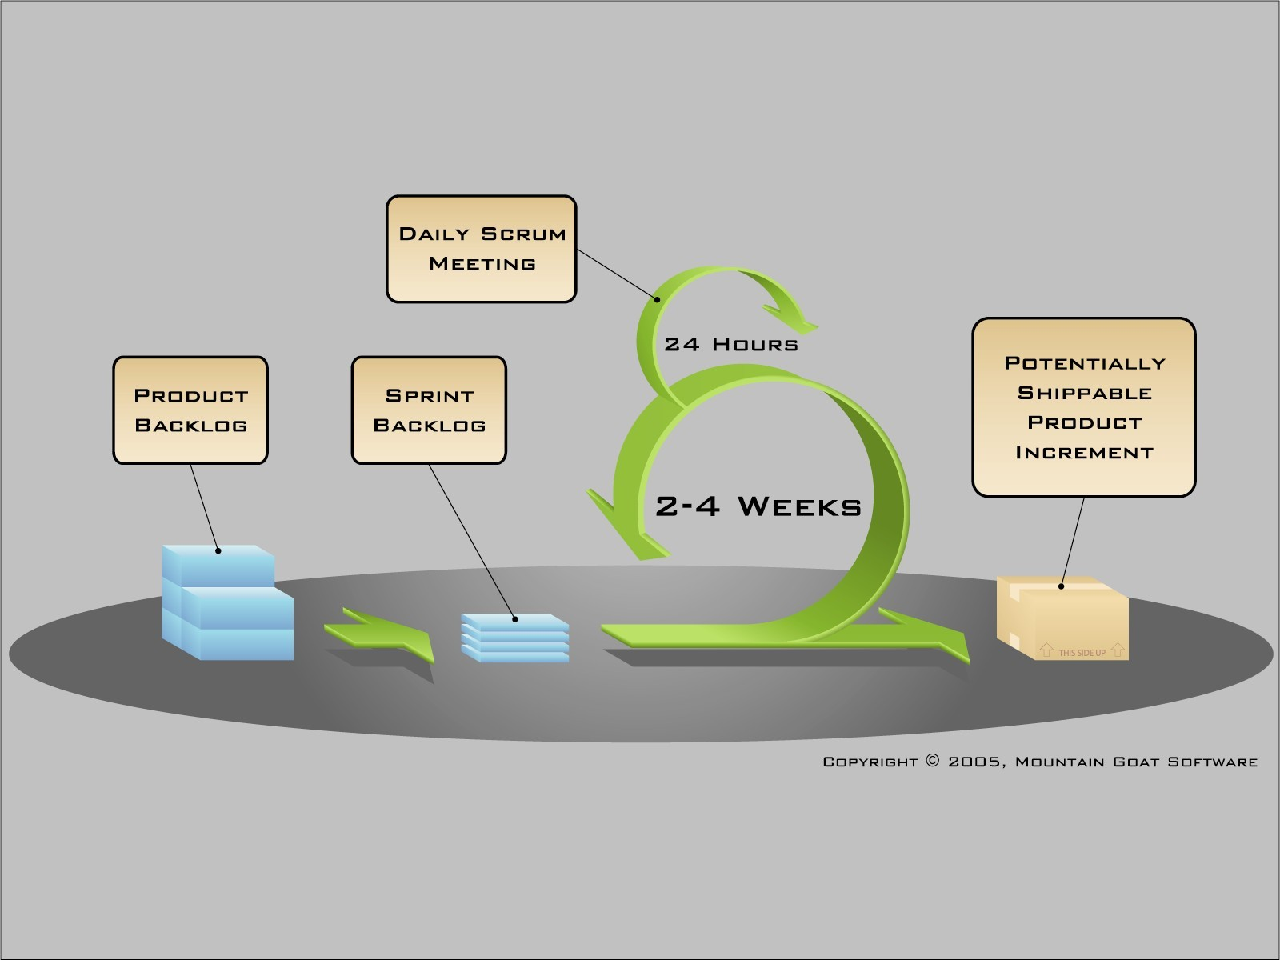
SCRUM
●
Ken Schwaber, Mike Beedle, Jeff Sutherland and others have contributed significantly to the evolution of Scrum over the last decade.
Scrum is a lightweight agile project management framework with broad applicability for managing and controlling iterative and incremental projects of all types.
●

Slide 15
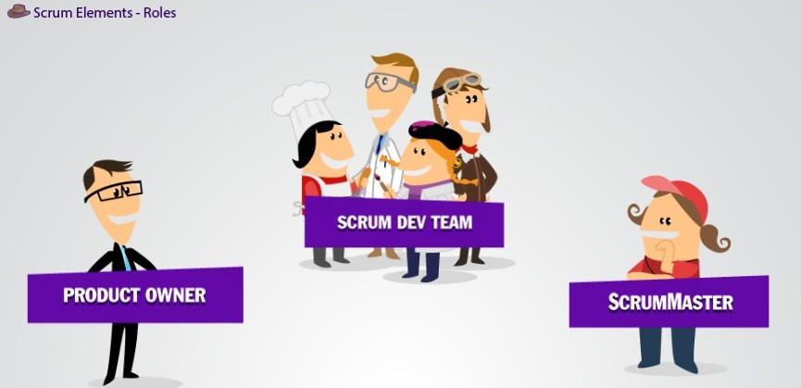
SCRUM ELEMENTS-ROLES

Slide 16

Product Owner
●
Single person responsible for maximizing the return on investment (ROI) of the development effort
Responsible for product vision
Constantly re-prioritizes the Product Backlog, adjusting any longterm expectations such as release plans
Final arbiter of requirements questions Accepts or rejects each product increment
Decides whether to ship
Decides whether to continue development Considers stakeholder interests
May contribute as a team member Has a leadership role
●
●
●
●
●
●
●
●
●

Slide 17

ScrumMaster
Scrum master is a core of scrum team
Doing scrum planning for a particular sprint
Manage dependencies and impediments
Is a part of scrum team not a manager
Responsible for scrum ceremonies (like daily stand-up ,demo, retrospective)






Slide 18
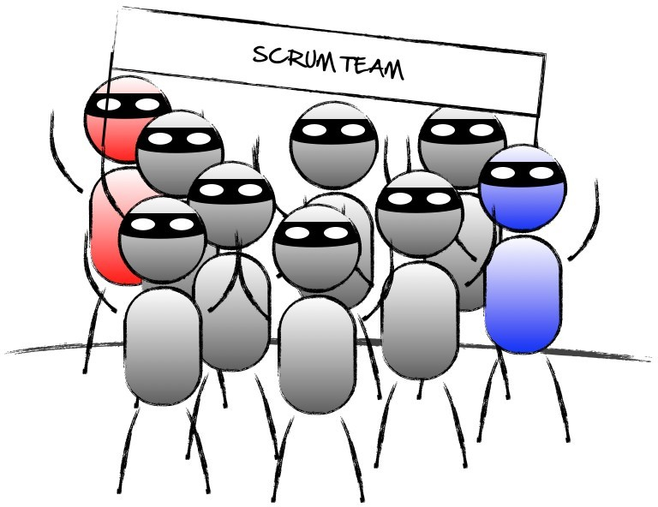
Scrum Development Team
●
Scrum Team works towards acheiving goal of the sprint. They work on scrum baklog item and take part in scrum ceremonies.
Scrum team take part in daily standup and discuss 3 things:
What was done yesterday?
What's the plan for today?
Any impediments?
●

Slide 19
THE PROCESS
Sprint Planning Meeting Sprint
Daily Scrum
Sprint Review Meeting
➢
➢
➢
➢

Slide 20
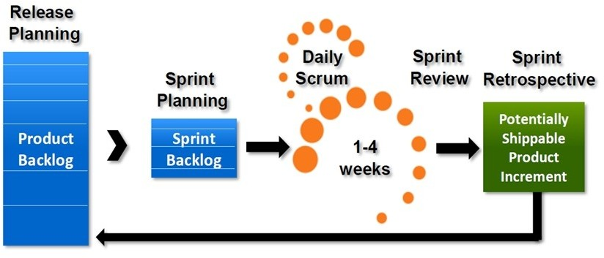
PROCESS

Slide 21

SPRINT
●
A month-long iteration, during which is incremented a product functionality
NO outside influence can interference with the Scrum team during the Sprint
Each Sprint begins with the Daily Scrum Meeting
●
●
JASS 2006
Agile Project Management - Scrum
21

Slide 22
Sprint Planning Meeting
●
A collaborative meeting in the beginning of each Sprint between the Product Owner, the Scrum Master and the Team
●
Takes 8 hours and consists of 2 parts (“before lunch and after lunch”)
●
The Product Owner and team negotiate which Product Backlog Items they will attempt to convert to working product during the Sprint. The Product Owner is responsible for declaring which items are the most important to the business.
●
The team is responsible for selecting the amount of work they feel they can implement without accruing technical debt. The team “pulls” work from the Product Backlog to the Sprint Backlog.

Slide 23
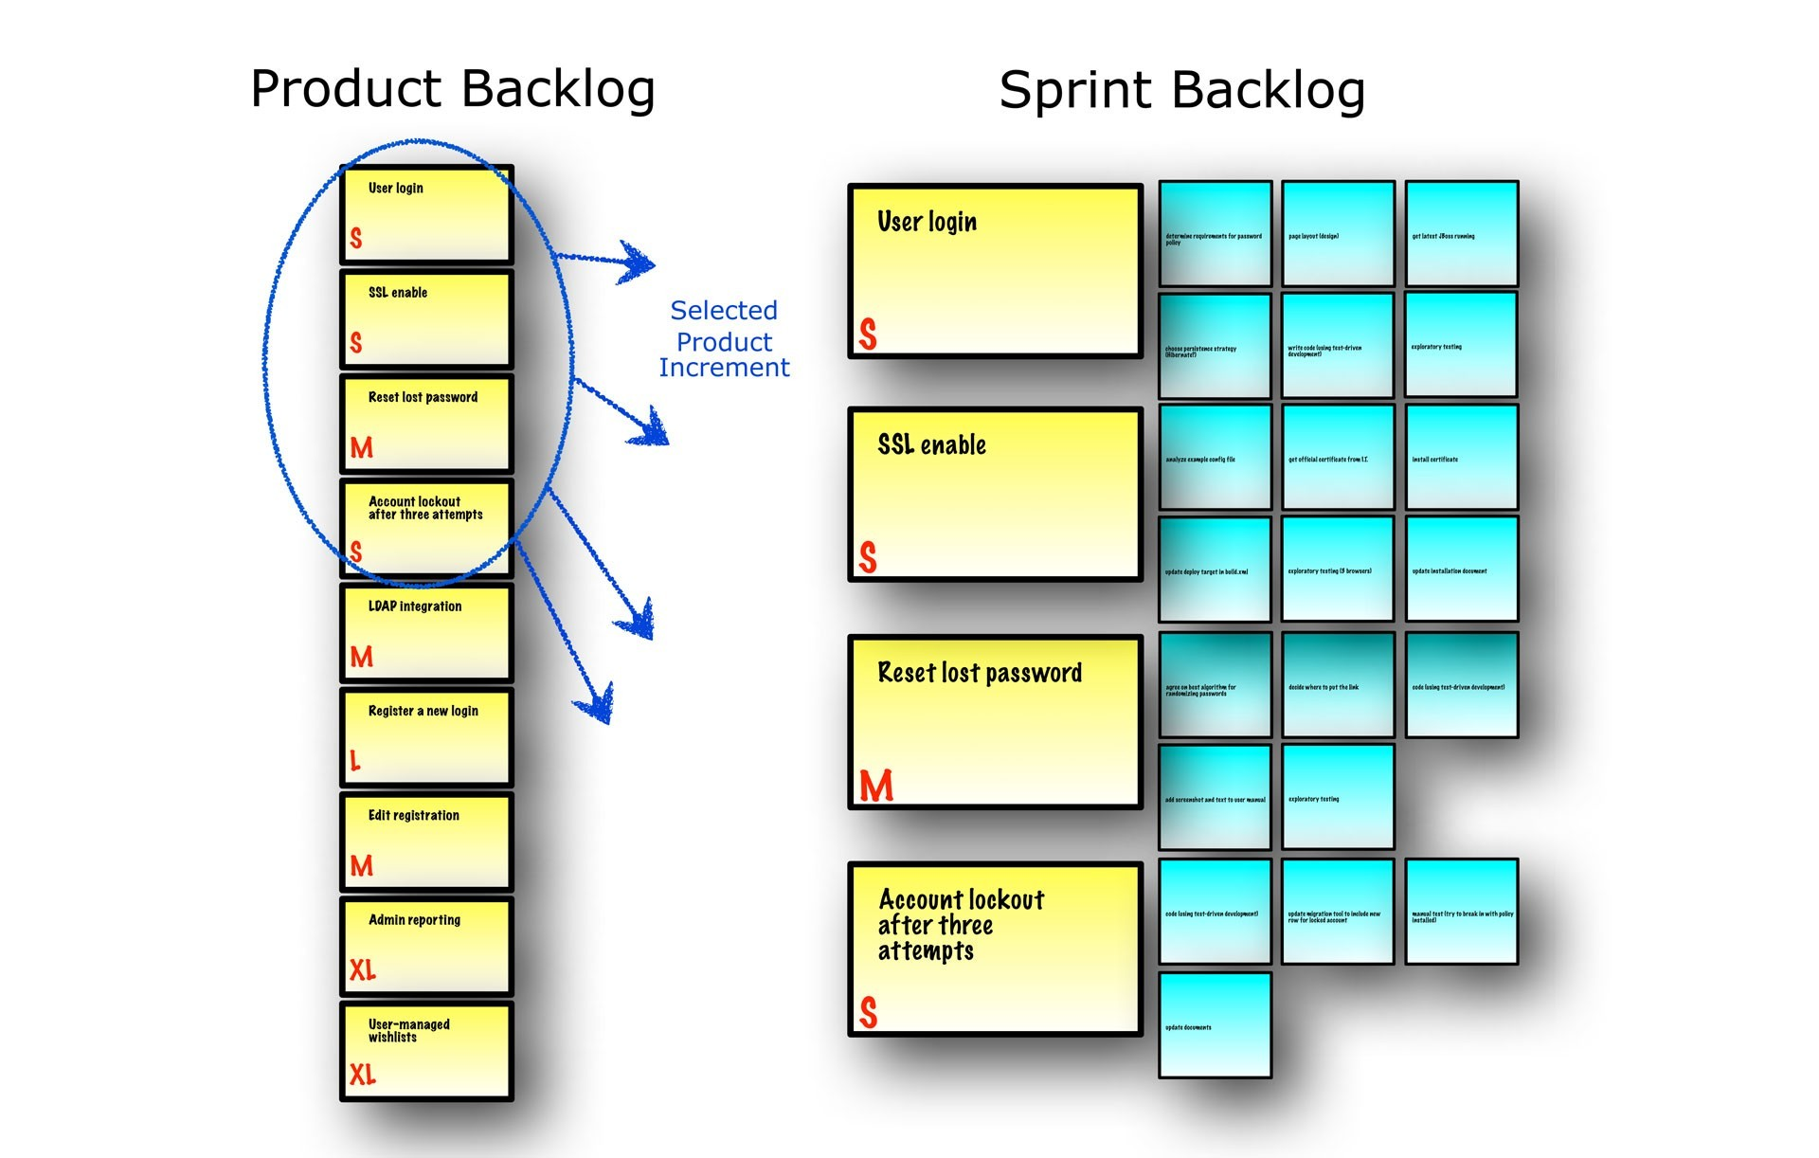
SPRINT PLANNING

Slide 24
Parts of Sprint Planning Meeting
1st Part:
Creating Product Backlog
Determining the Sprint Goal.
Participants: Product Owner, Scrum Master, Scrum Team
2nd Part:
Participants: Scrum Master, Scrum Team
Creating Sprint Backlog

Slide 25
Difference between Product Backlog & Sprint Backlog
●
Managed by product owner and contains a high-level view of all the work that your team must complete to create the product. Your product owner ranks the user stories in the product backlog and provides sufficient detail during the sprint planning meeting so that your team can estimate and implement each user story.
In contrast, your team creates the sprint backlog, which contains a detailed list of all the tasks that your team must complete to finish the user stories for the sprint. In the product backlog, your team estimates user stories with the relative unit of story points. In the sprint backlog, your team estimates tasks in hours.
Your product owner updates the product backlog every week, but your team updates the sprint backlog at least daily.
Your product owner maintains the same product backlog throughout the project, but your team creates a new sprint backlog for each sprint.
●
●
●

Slide 26
Pre-Project/Kickoff Meeting
A special form of Sprint Planning Meeting Meeting before the begin of the Project

Slide 27
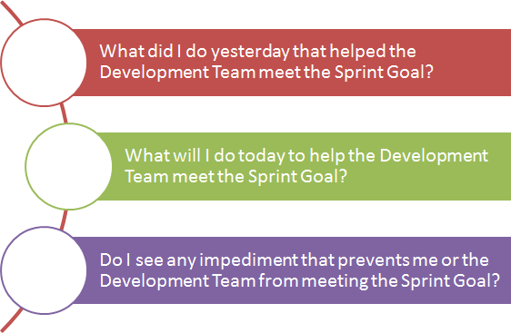
DAILY SCRUM

Slide 28
SPRINT REVIEW MEETING
Is held at the end of each Sprint
Business functionality which was created during the Sprint is demonstrated to the Product Owner
Informal, should not distract Team members of doing their work
●
●
●
JASS 2006
Agile Project Management - Scrum
28

Slide 29
SCRUM ARTIFACTS
Product Backlog Sprint Backlog Burn down Charts




Slide 30
Product Backlog
Requirements for a system, expressed as a prioritized list of Backlog Items
Is managed and owned by a Product Owner Spreadsheet (typically)
Usually is created during the Sprint Planning Meeting Can be changed and re-prioritized before each PM
●
●
●
●
●

Slide 31
Sprint Backlog
No more then 300 tasks in the list
If a task requires more than 16 hours, it should be broken down
Team can add or subtract items from the list. Product Owner is not allowed to do it.
●
●
●

Slide 32
Burn down Charts
Are used to represent “work done”. Are wonderful Information Radiators 3 Types:
Sprint Burn down Chart (progress of the Sprint) Release Burn down Chart (progress of release) Product Burn down chart (progress of the Product)
●
●
●
●
●

Slide 33
Thank You!

